Slide 1

José Ortiz
Maribel Ojeda

Slide 2
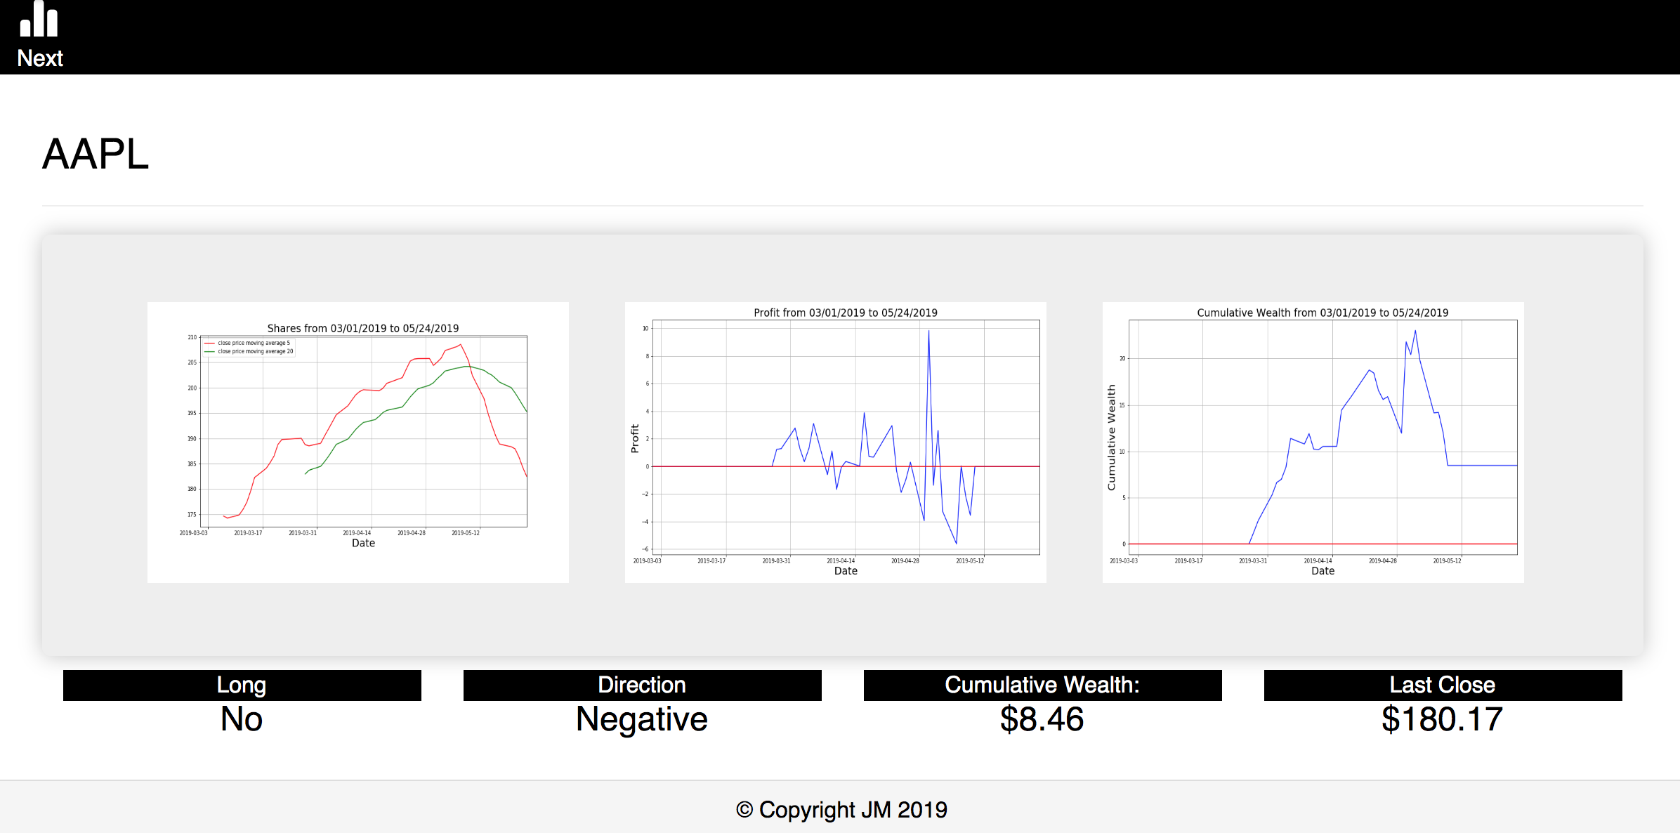
A stock market recommendation system was created using the Extract, Transform, and Load method
Recommendation System
Extract
Transform
Load
SLACK Chatbot

Slide 3
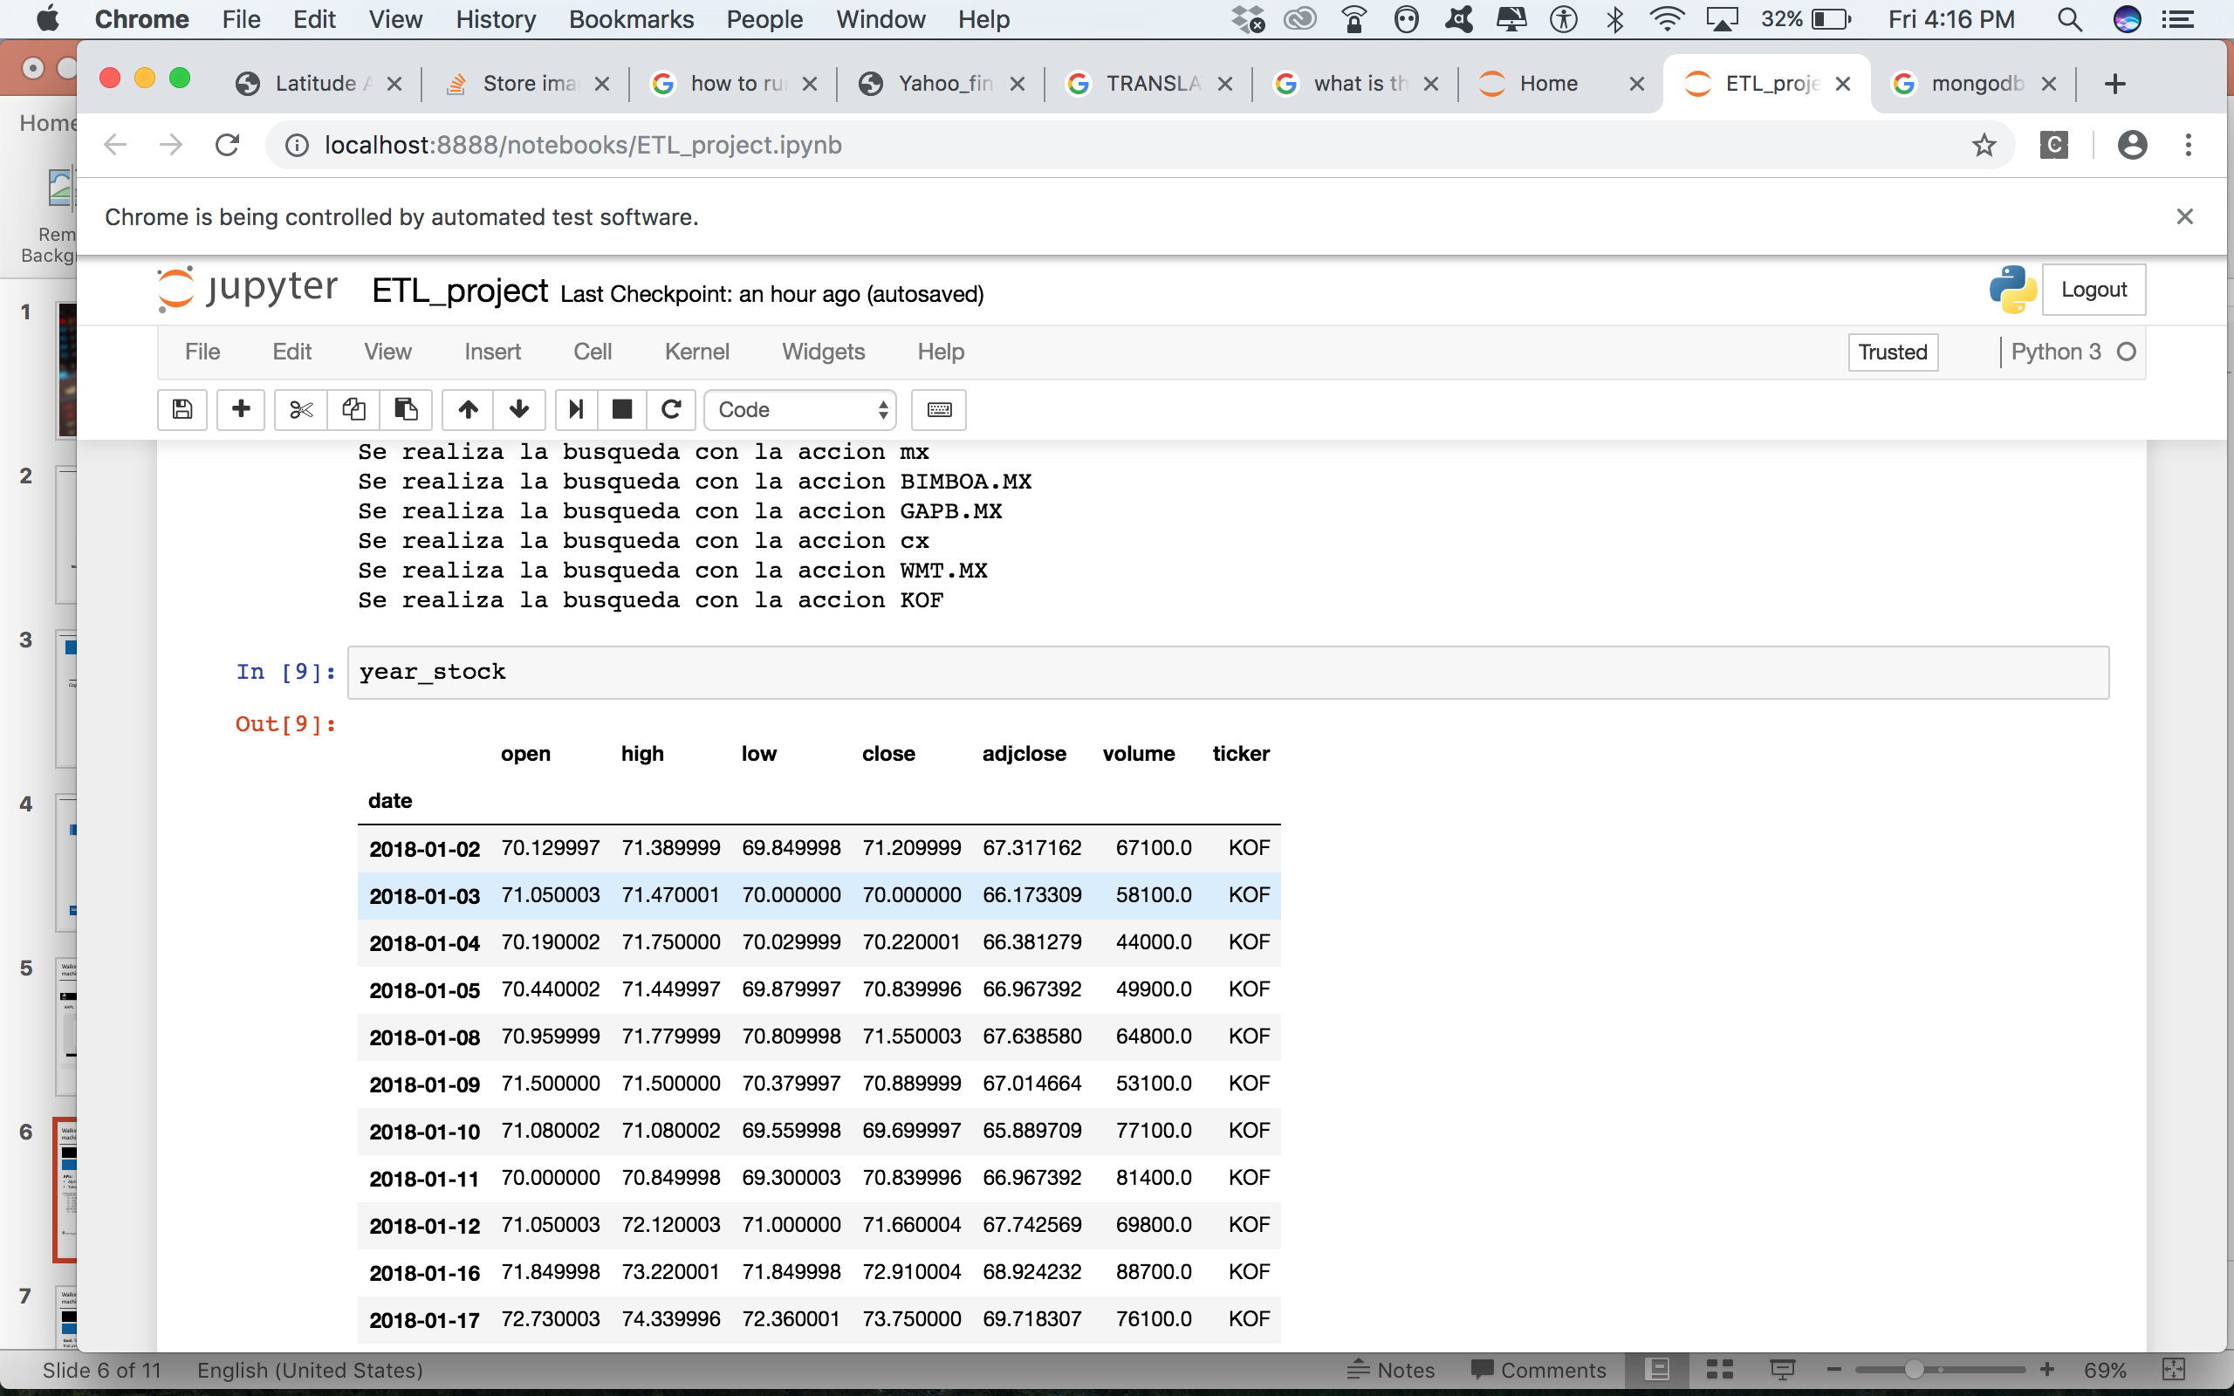
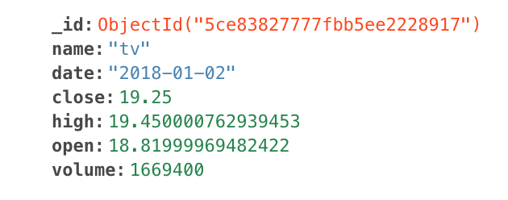
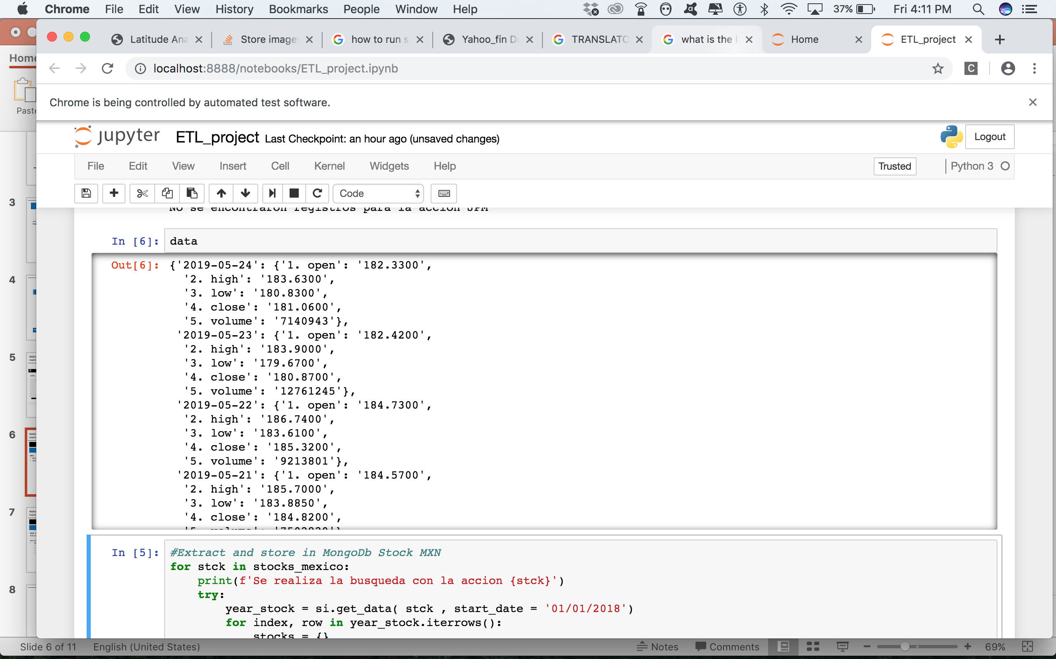
Yahoo Finance and Alpha Vantage APIs were used to extract the data. Then it was stored using MongoDB
Recommendation System
Extract
Transform
Load
Sources-APIs
Database
Db. Structure
A database called Stocks was created with two raw data tables:
BMV (9 companies)
International (24 companies)
Why?
It is used as an analytics database to feed the dashboard
The project does not require to relate tables
It is more user friendly than MySQL.

Slide 4
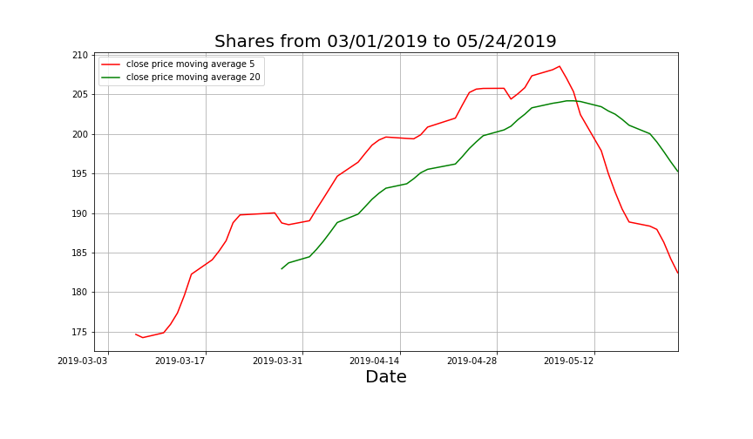
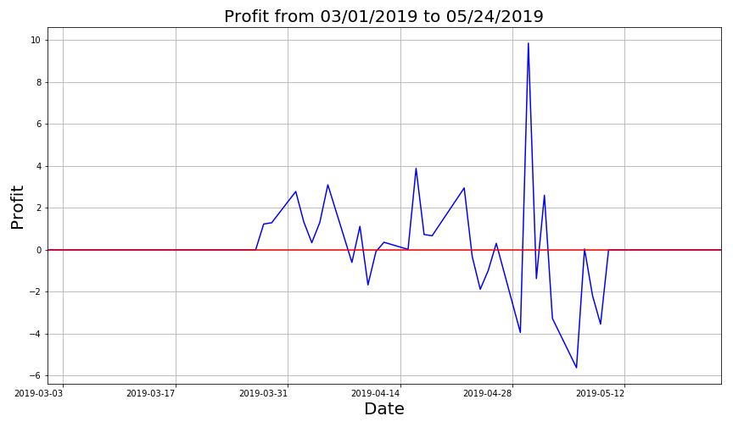
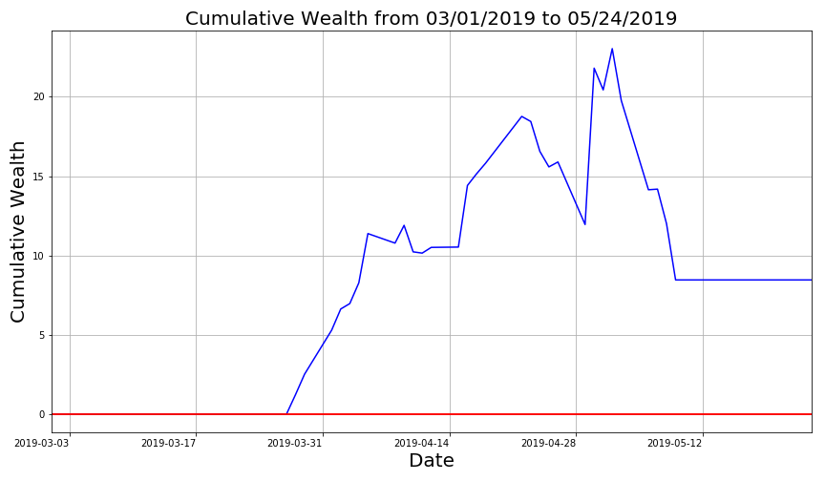
A basic trading strategy was defined and computed using the close price and the date as the main base parameters.
Recommendation System
Extract
Transform
Load
The trading strategy was defined using the following parameters and plots:
Share: Difference between two moving averages of different length. If the smaller length is higher you can long the stock.
Price difference: Todays close price vs. yesterday close price.
Direction: Sign of the price difference.
Profit: Price difference if the share is positive.
Cumulative Wealth: Cumulative sum of all previous profits.

Slide 5
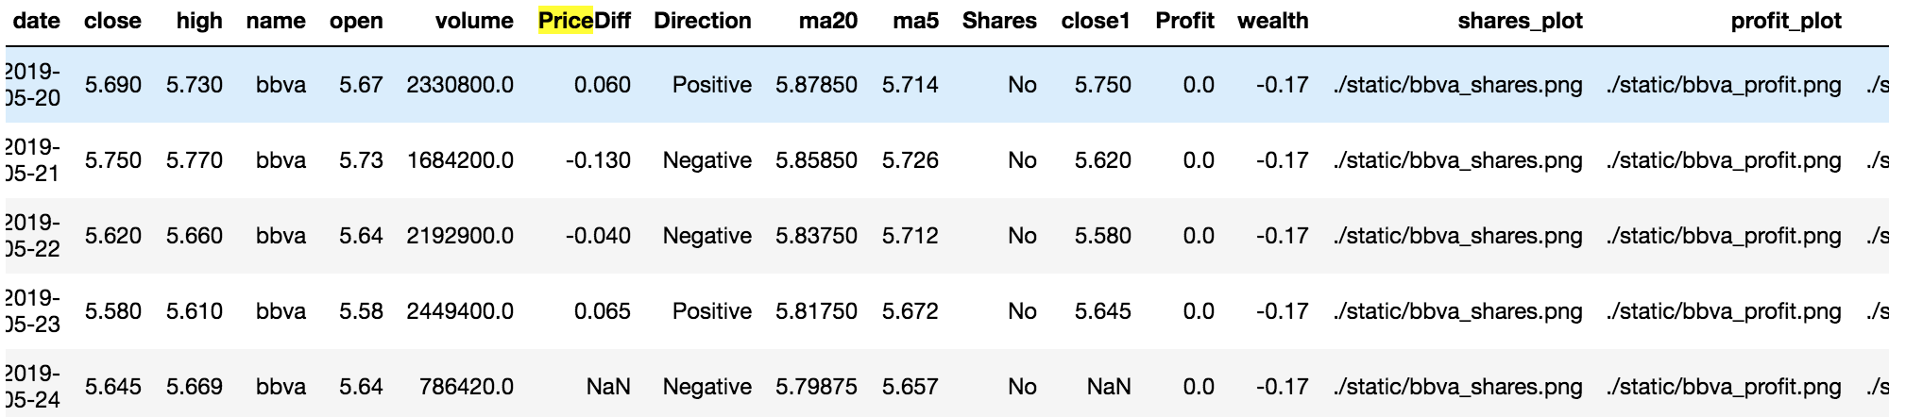
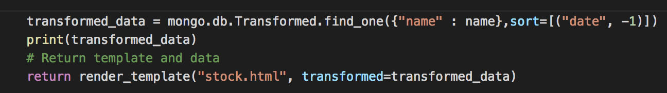
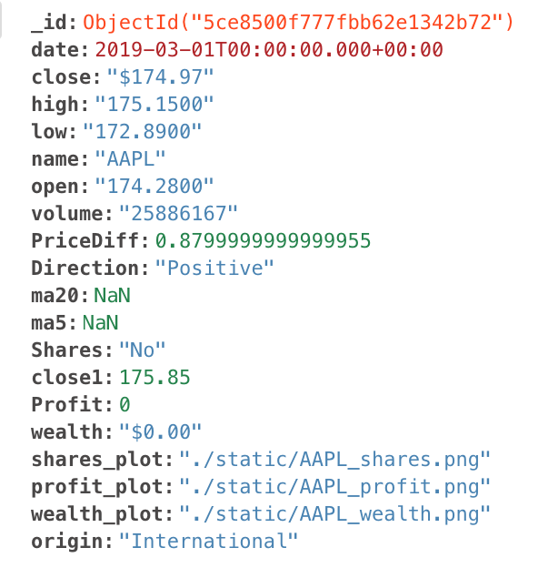
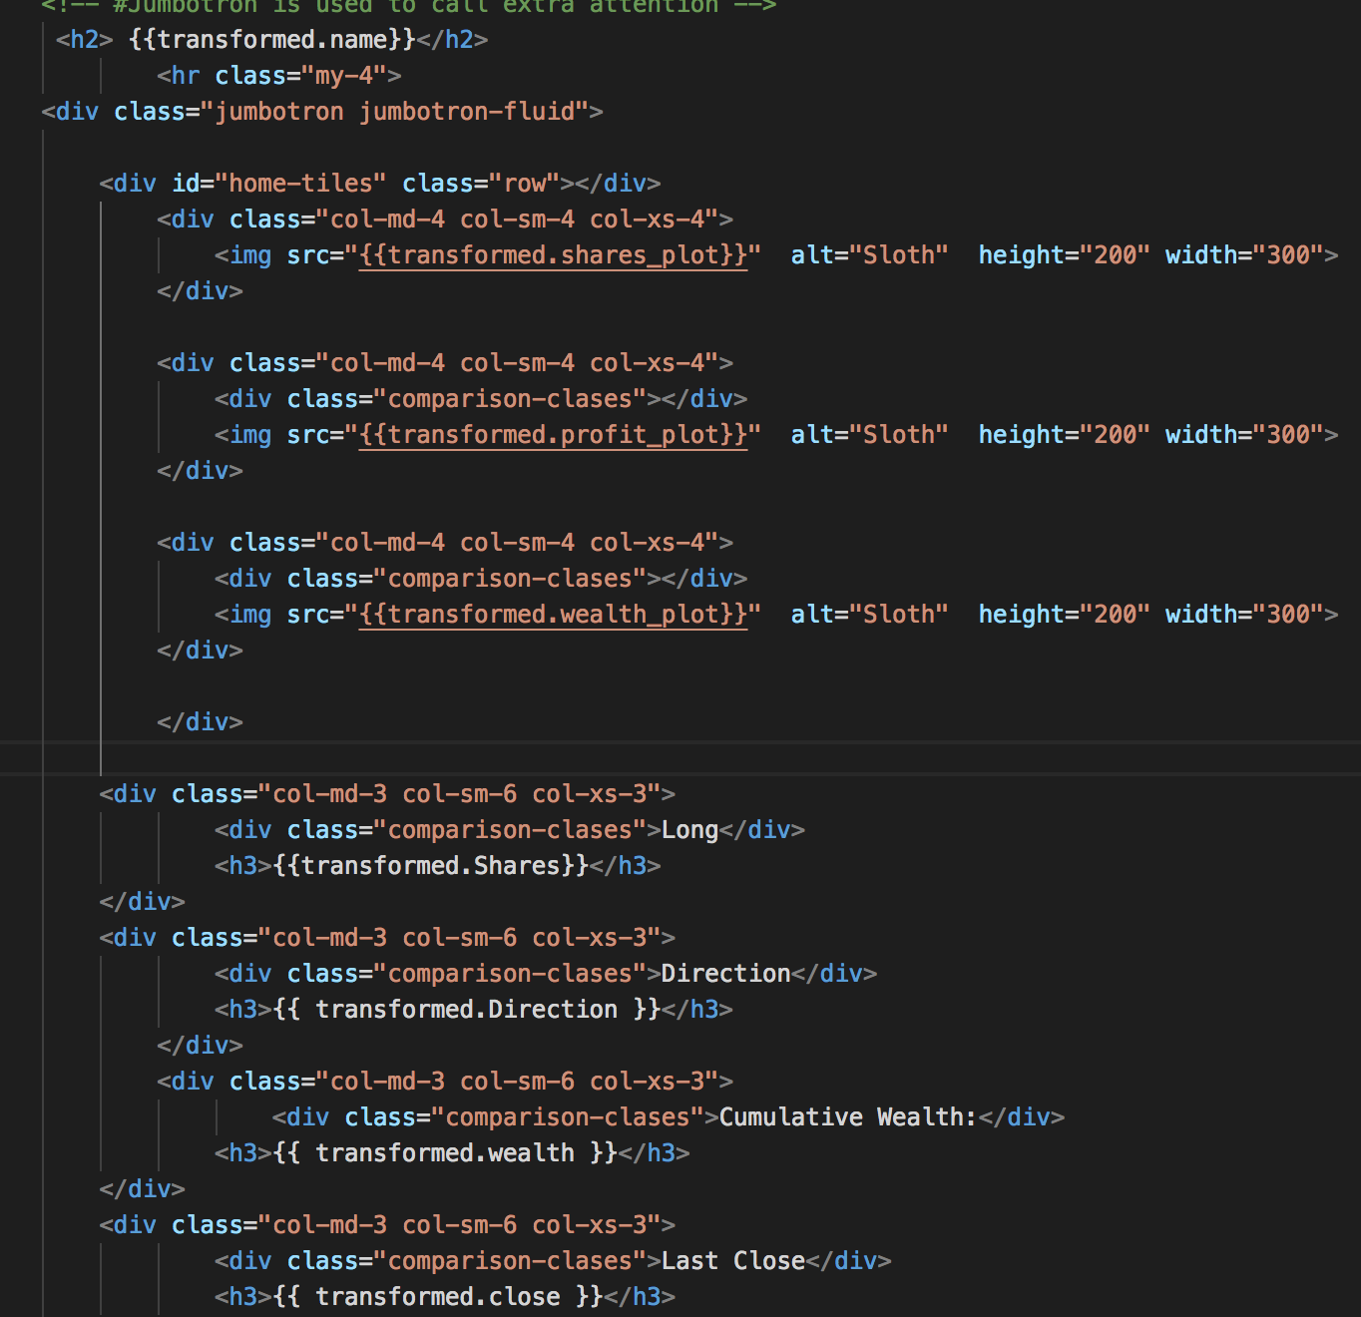
Each parameter of the strategy was stored as a time series in a panda data frame and then loaded into a new table in MongoDB to serve as a “Real-time” analytics database for the flask app
Recommendation System
Extract
Transform
Load
Queries
Flask app
HTML
Transformed
Table

Slide 6
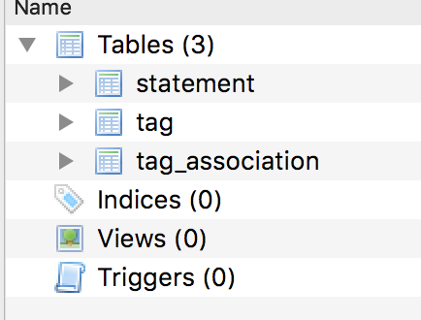
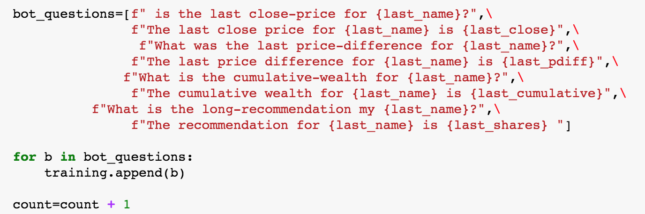
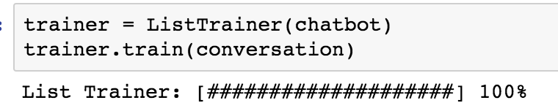
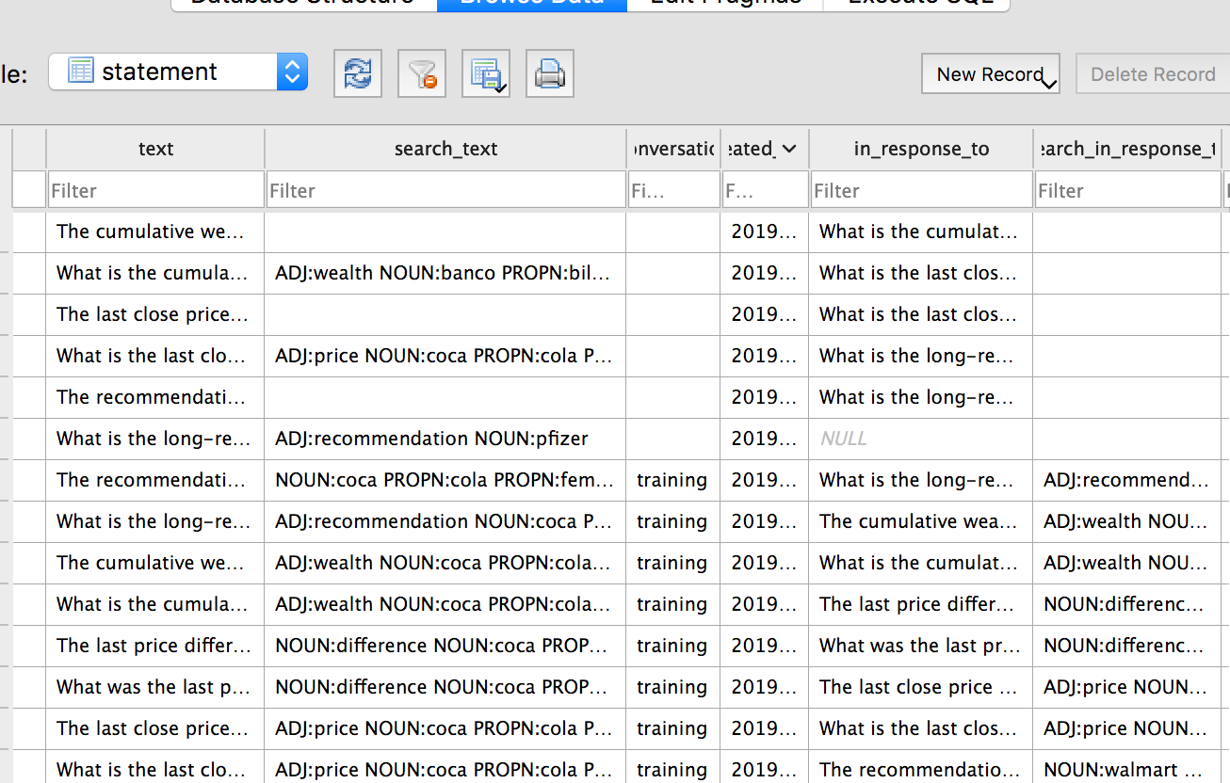
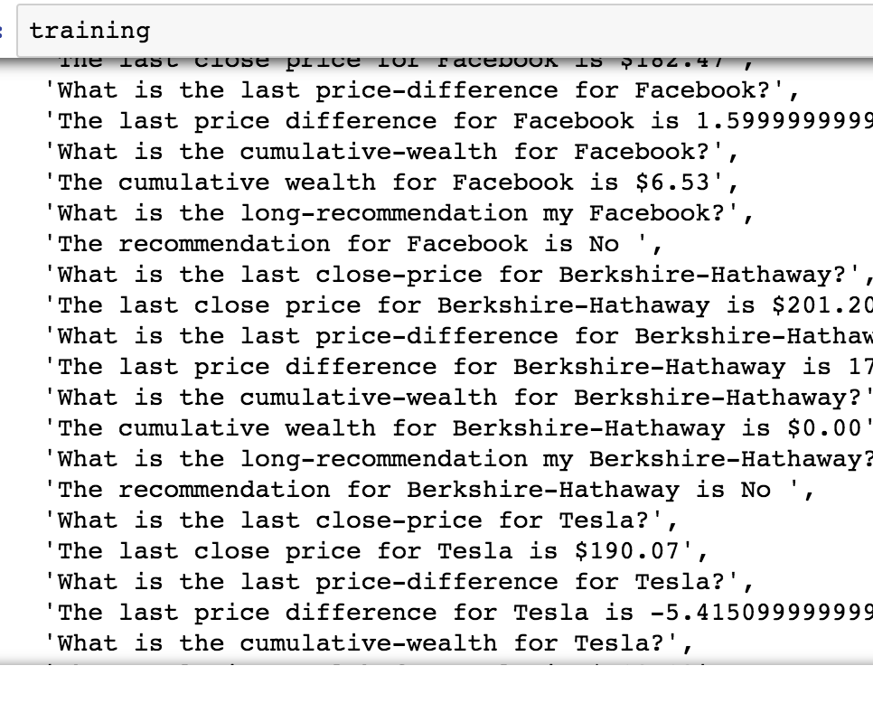
From the previous process, a conversation was created and stored into a list in order to train our chatbot
Chatbot
Extract
Transform
Load
For each company
We simulate a conversation in a Python array:

Slide 7


Slide 8
Backup
8

Slide 9
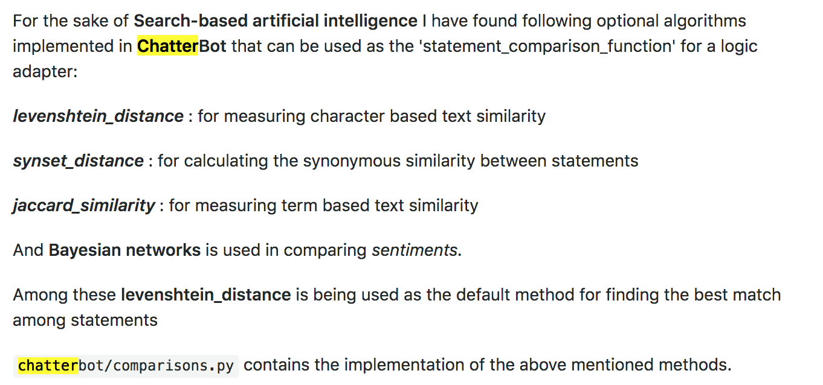
Chatterbot techniques

Slide 10
Possible Questions
What is the long-recommendation my Pfizer?
BOT: The recommendation for Pfizer is Yes
>>>What is the last close-price for Coca-Cola-FEMSA?
BOT: The last close price for Coca-Cola-FEMSA is $63.66
>>>What is the cumulative-wealth for Banco-Bilbao-Vizcaya-Argentaria?
BOT: The cumulative wealth for Banco-Bilbao-Vizcaya-Argentaria is $-0.17
foreign_name=["Apple","Google","Microsoft","Amazon","Facebook","Berkshire-Hathaway","Tesla",\
"JPMorgan","Exxon-Mobil","Bank of America","Walmart","Wells-Fargo","Visa",\
"Procter&Gamble","Anheuser-Busch","AT&T","Chevron","UnitedHealth",\
"Pfizer","China-Mobile-Limited","Hyatt-Hotels","Intel","Taiwan-Semiconductor-Manufacturing",\
"Verizon"]
bot_questions=[f" is the last close-price for {last_name}?",\
f"The last close price for {last_name} is {last_close}",\
f"What was the last price-difference for {last_name}?",\
f"The last price difference for {last_name} is {last_pdiff}",\
f"What is the cumulative-wealth for {last_name}?",\
f"The cumulative wealth for {last_name} is {last_cumulative}",\
f"What is the long-recommendation my {last_name}?",\
f"The recommendation for {last_name} is {last_shares} "]
['tv', 'kof', 'bbva', 'mx', 'BIMBOA.MX', 'GAPB.MX', 'cx', 'WMT.MX', 'KOF']
mexico_name=["Televisa","Coca-Cola-FEMSA", "Banco-Bilbao-Vizcaya-Argentaria","MagnaChip-Semiconductor",\
"Bimbo","Grupo-Aeroportuario-del-Pacífico","Citigroup","Walmart-Mexico","Coca-Cola-FEMSA"]

